Slide 1

Team Name: StrivingGeeks
Team Details:
Aditi Srivastava
Vandana Sah
Vaishnavi

Slide 2


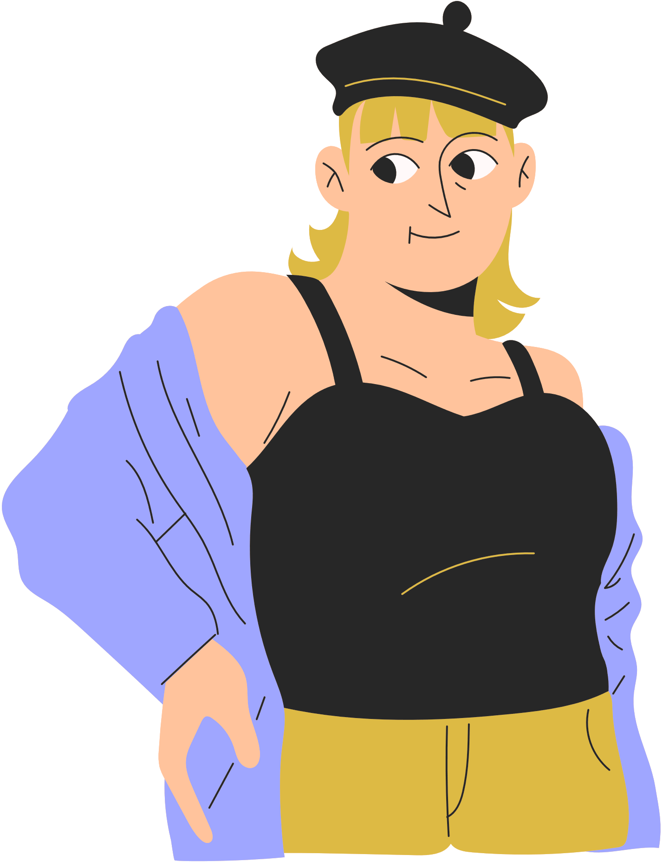

PROBLEM STATEMENT
The wildly inconsistent sizing standards and the inability to find a complete outfit for oneself. .
Today's online shopping landscape is fraught with the impersonal and detached shopping experiences.
.
?
Small-scale fashion designers often struggle with local visibility. With smart social media use, they can showcase their unique designs to a broader audience and ride the trend wave. .

Slide 3


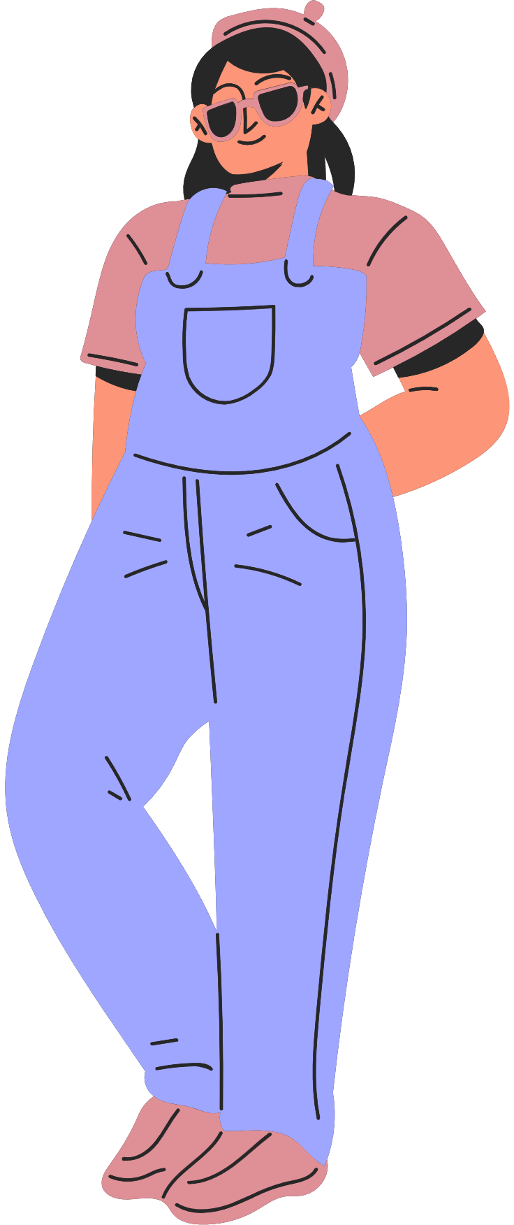

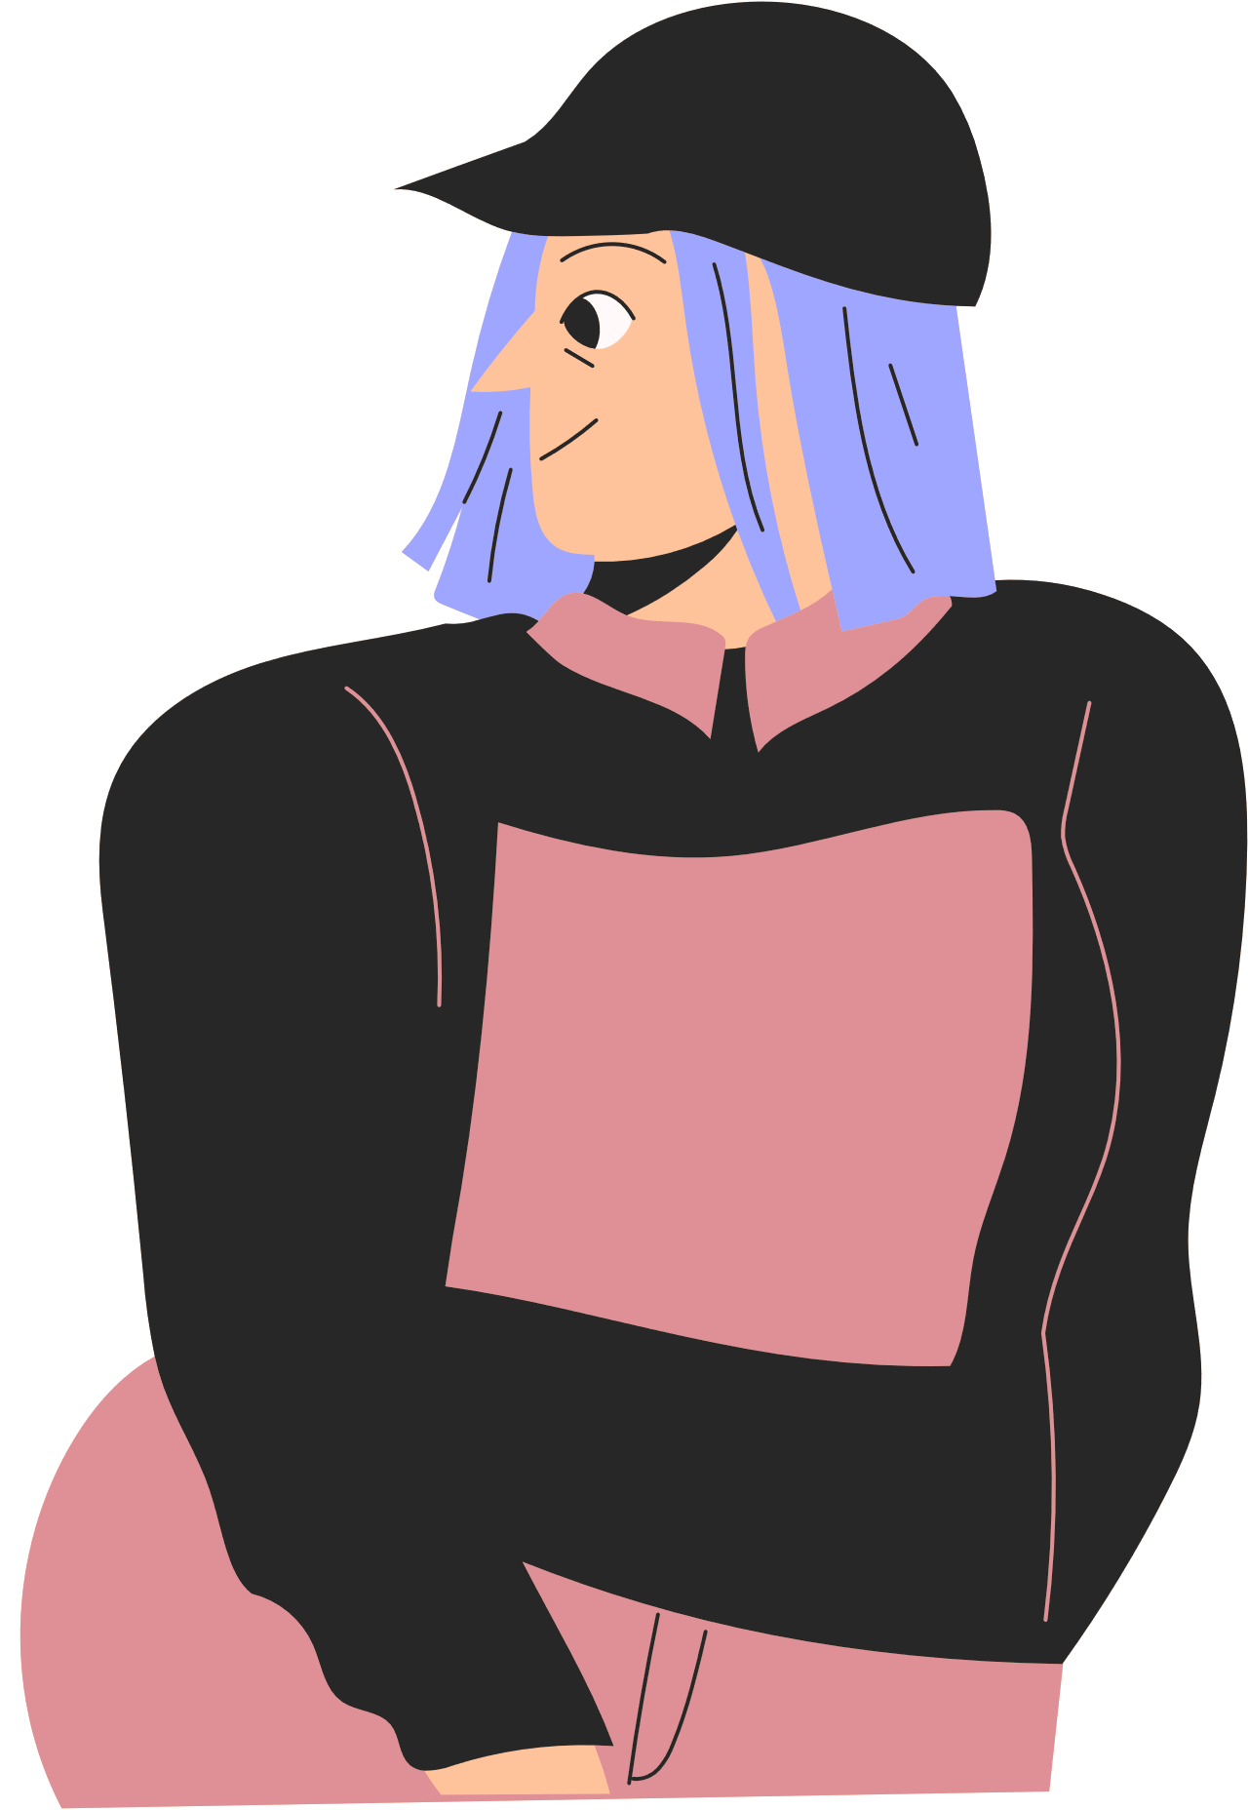
SOLUTION
Our platform serves up a fun and tailored online shopping experience with spot-on sizing tools and virtual try-ons to cut down on returns.
Additionally, we give small-scale fashion designers a boost by supercharging their social media presence and help them flaunt their unique designs to a larger audience.
Users can also create a complete outfit from head to toes, and share it on social media to earn reward points.

Slide 4
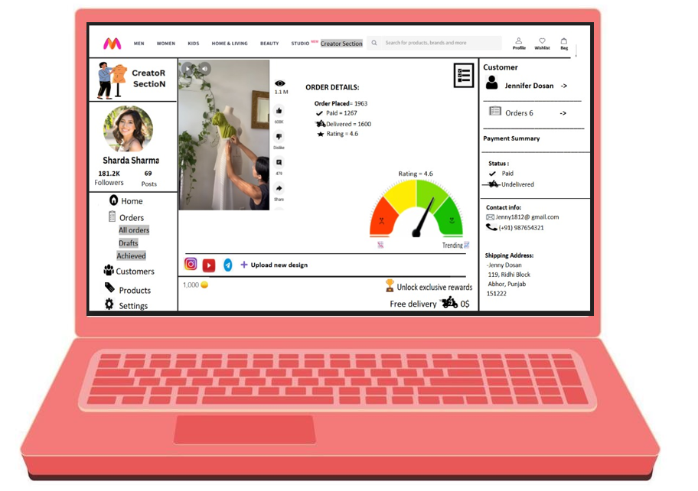
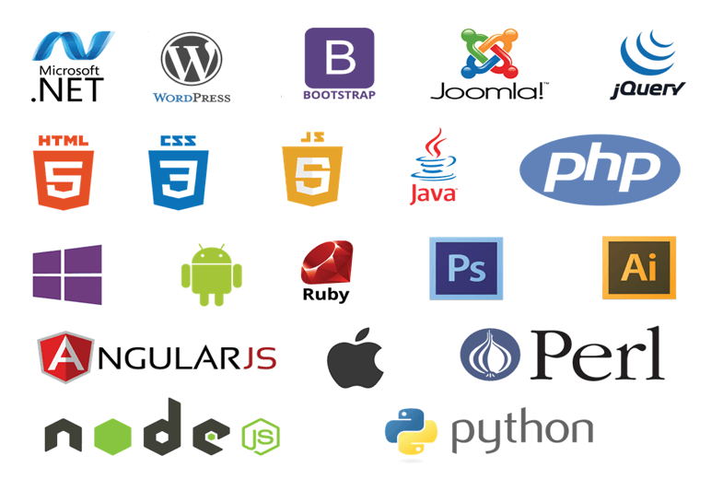

CREATOR SECTION
TECH-STACK
HTML
CSS
JS
NODE JS
REACT
MONGODB
REDUX,etc.
REWARDS
TREND METER

Slide 5
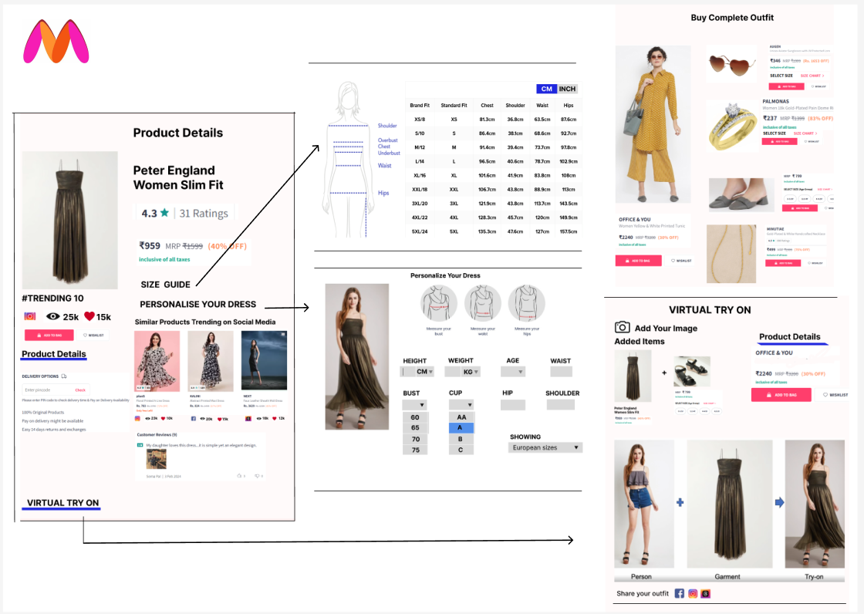

Slide 6

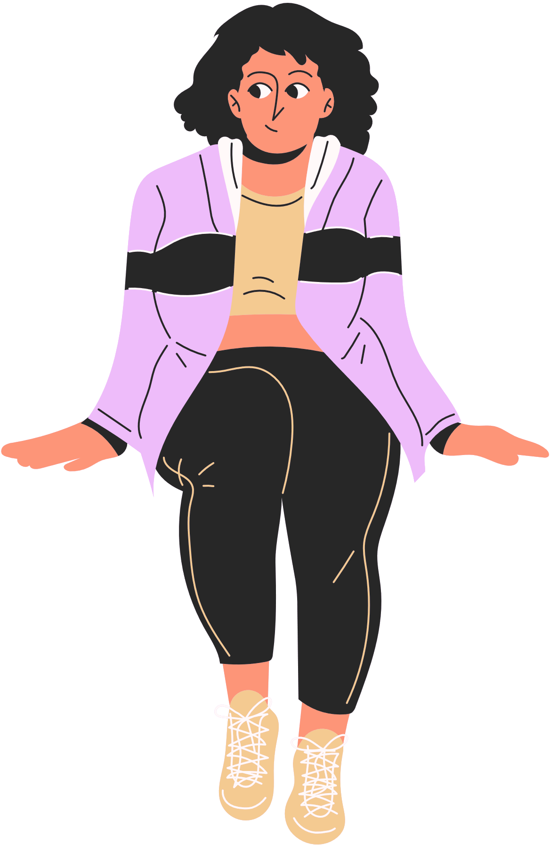

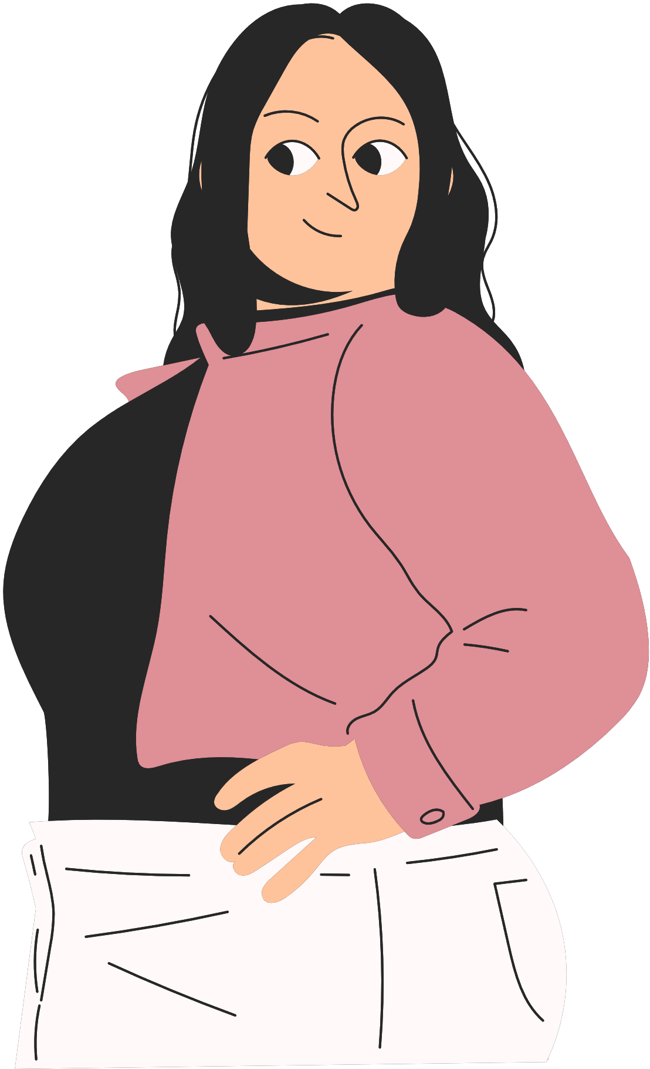
1
Perfect Fit, No Fuss: Our spot-on sizing tools make sure you get clothes that fit like a glove, no returns needed!
BENEFITS
2
Designer Spotlight: We help small-scale fashion designers shine on social media, by sharing their creations to a wider audience.
3
Stylish Rewards: Create full outfits, share them on social media, & earn reward points for discounts and perks.
Fashion Community Vibes: Join a vibrant community of fashion lovers, sharing the latest trends &looks.
4

